Slide 1
ChemE 599: Image Analysis for Scientists and Engineers
Lecture 7: Color Images
Prof. Chad Curtis
Mar. 30, 2020

Slide 2
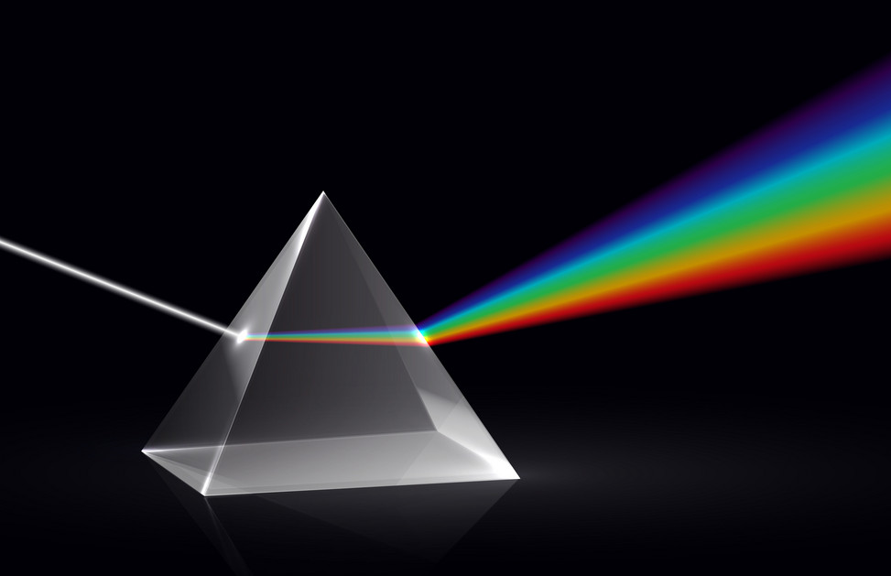
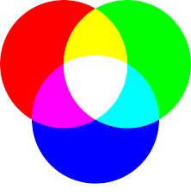
The Science of Color
Light is a continuous spectrum
We perceive light as a mixture of three wavelengths:
Red (575 nm)
Green (535 nm)
Blue (445 nm)
Notes:
Primary colors of light versus the primary colors of pigments.

Slide 3
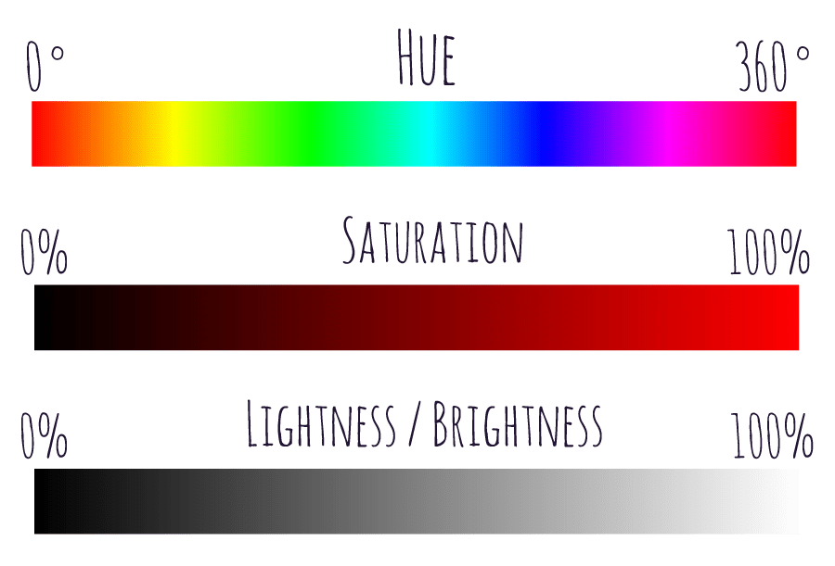
Quantifying Light
Brightness: A measurement of intensity, corresponding to an image’s gray level when dealing with black and white images.
Hue: Associated with the dominant wavelength in a mixture of waves. When you refer to a color as red, you are referencing its hue.
Saturation: Relative purity or the amount of white light mixed with a hue.

Slide 4
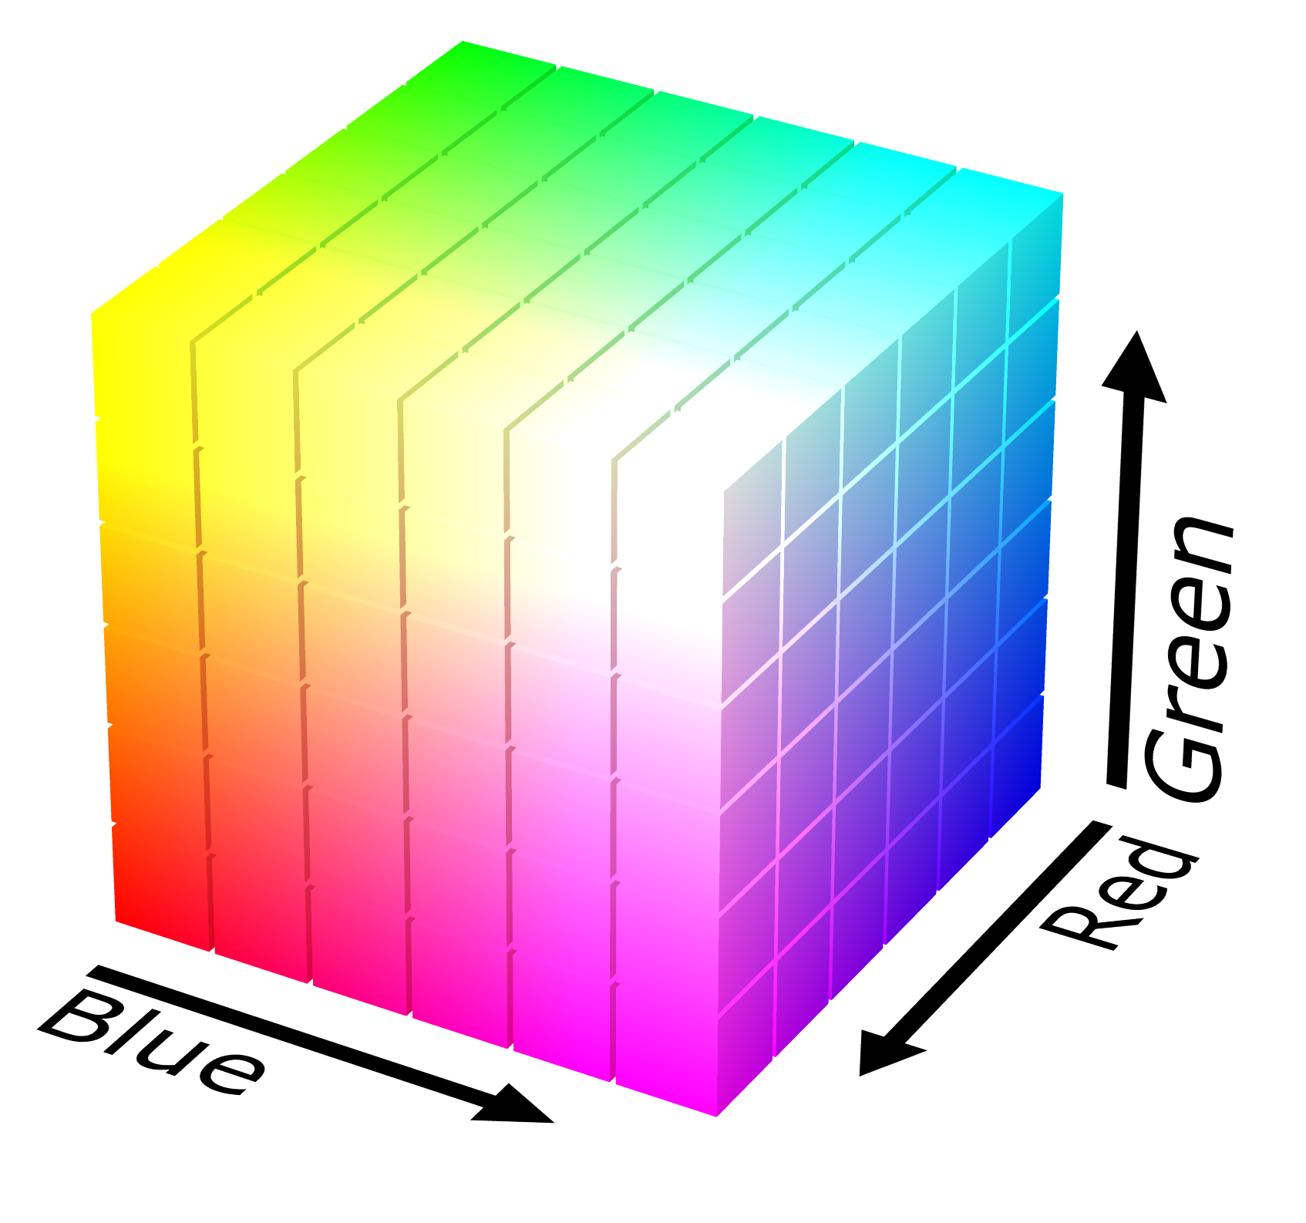
RGB Color Model

Slide 5
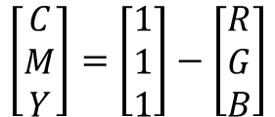
CMY Color Model
Essentially the same as the RGB model, but expressed using the secondary colors instead of the primary colors.
$$\left[\begin{matrix}C \\ M \\ Y\end{matrix}\right]=\left[\begin{matrix}1 \\ 1 \\ 1\end{matrix}\right]−\left[\begin{matrix}R \\ G \\ B\end{matrix}\right]$$
Most devices that deposit colored pigments require data in the CMY scale, or perform the conversion themselves.

Slide 6
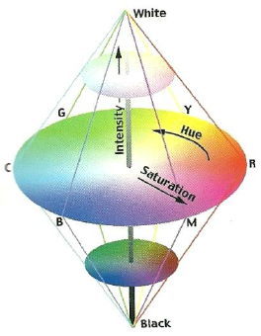
HSI Color Model
Better suited for human interpretation of color data (You do not refer to the percent red, green, blue when describing a color!)

Slide 7
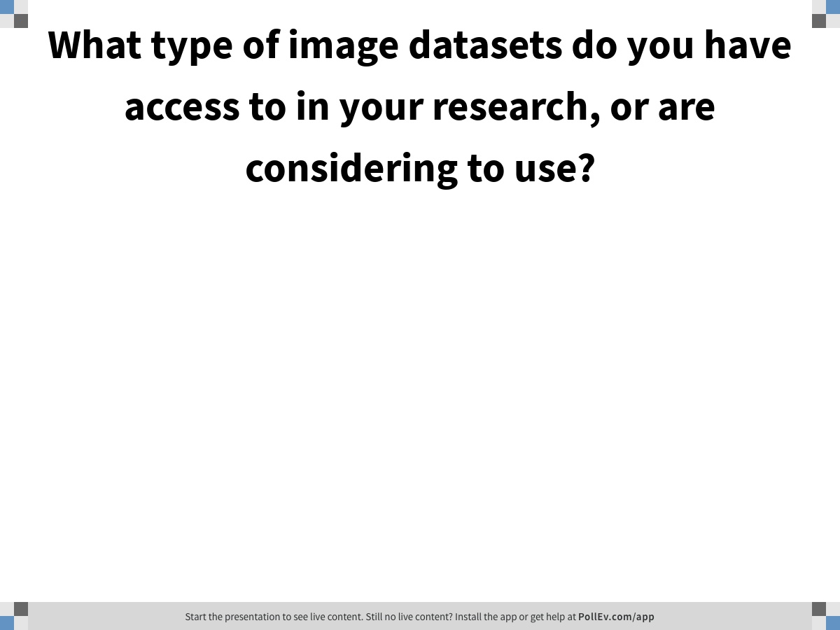
Notes:
Poll Title: What type of image datasets do you have access to in your research, or are considering to use? https://www.polleverywhere.com/free_text_polls/mRTLpInvn7fpZv0KNcelZ

Slide 8
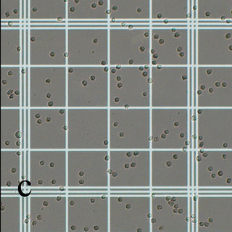
Hemocytometer images: Image morphology
Problem: I have hundreds of hemocytometer images to perform cell counts, but I think I could make this process much quicker if I could automate the process.
Possible solutions: binarize image into cells (black) and background (white); Canny edge detector
Problems: False positives (objects that are not cells counted as cells); false negatives (cells missed); overlapping cells; what threshold to use; non-uniform lighting

Slide 9
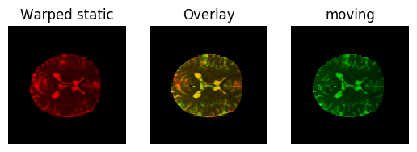
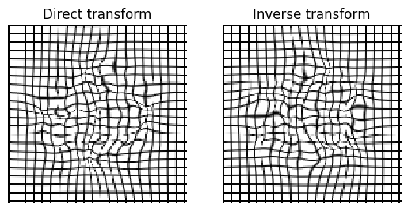
Neuroanatomical Datasets: Image registration
Problem: I am trying to compare stacks of MRI images of different patients, but I can’t compare them directly because they have different frames of reference.
Possible solutions: diffeomorphic image registration
Problems: Images aren’t similar enough, images are too big to process effectively

Slide 10
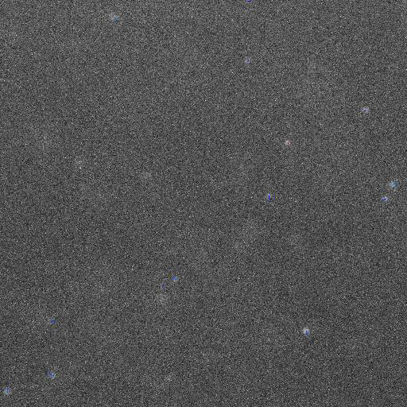
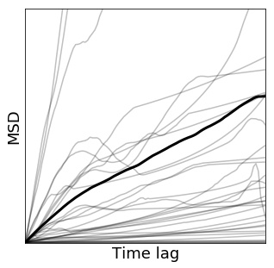
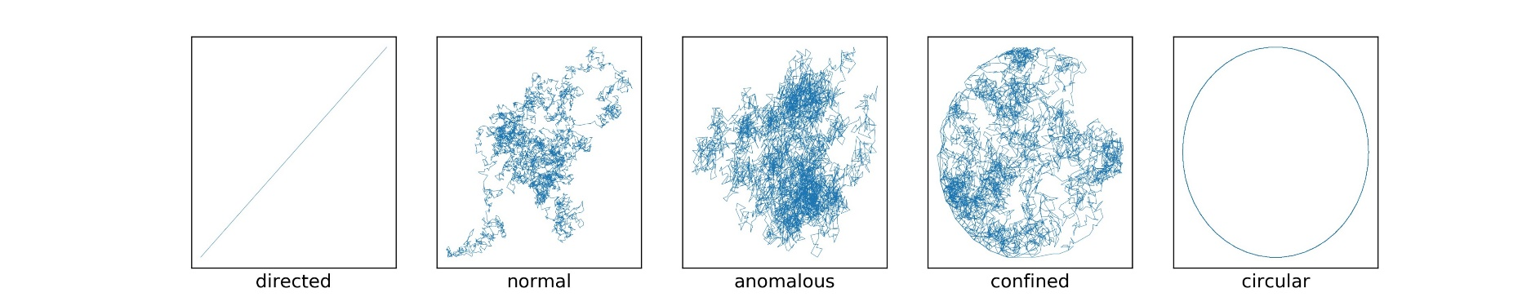
Diffusing nanoparticles: Feature tracking and machine learning
Problem: I have videos of nanoparticles diffusing in different conditions, and I want to quantify the differences in their behavior.
Possible solutions: feature identification and tracking
Problems: false positives, false negatives, frame rate, objects leaving frame

Slide 11
Quantify tissue damage: Object recognition

